Slide 1
Semantic Role Labelling in Hindi Interim Report
30 April 2021
Team Name - TeamRapids
Members - Rahul Mehta & Tejasvi Chebrolu

Slide 2
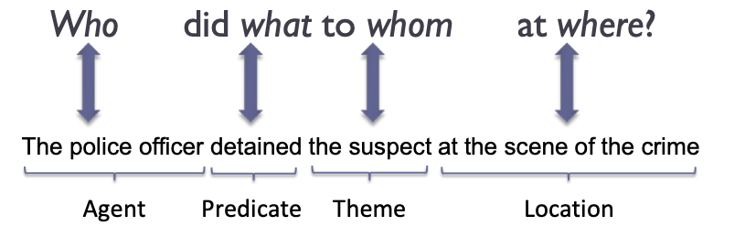
Problem Statement
Semantic Role Labelling or also called Thematic role labelling is a task of identifying the type of argument(also called semantic roles) that relates to a predicate, which is the main verb of the sentence.
For ex -
The problem of SRL can further be decomposed into
Predicate detection
Predicate sense disambiguation
Argument Identification - Given a sentence and a verb/predicate, identify the arguments for that verb
Argument Classification - After arguments are identified, assign a semantic label like DOER, THEME, LOCATIVE, CAUSE, PURPOSE etc
In this project, will like to focus our efforts on building an SRL system focussed on Hindi language and solving Argument Identification and Argument Classification by utilising the Hindi Propbank

Slide 3
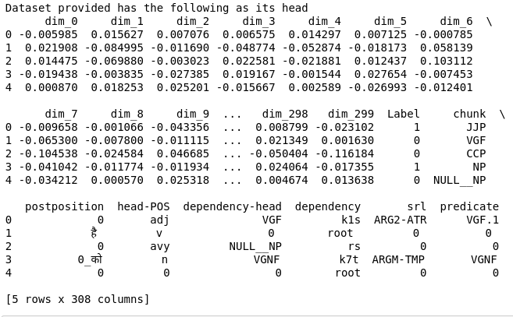
Dataset
Hindi Propbank
Multi-Layered Treebank for Hindi and Urdu that provides -
Dependency Treebank
PropBank
Phrase Structure Treebank
Main Features -
Vector
Embeddings with 300 dimensions
Additional Features apart from SRL tag

Slide 4
Argument Classification - Data Preparation
Step 1 - We processed around 14546 chunks of hindi text and do a 33% split for test set and remaining for train set
 | Train | Test | Total
Number of samples | 9745 | 4801 (33%) | 14546
Step 2 - We create around 300 features for each of the chunks using pre-trained word embeddings
Target Variable - We have 23 labels of argument classes
['ARG2-ATR' '0' 'ARGM-TMP' 'ARGM-LOC' 'ARG1' 'ARGM-PRP' 'ARG0' 'ARGM-CAU'
'ARG2-GOL' 'ARGM-MNR' 'ARGM-EXT' 'ARG2' 'ARGM-ADV' 'ARGM-DIS' 'ARG2-SOU'
'ARG2-LOC' 'ARGM-DIR' 'ARGM-MNS' 'ARGM-NEG' 'ARGM-PRX' 'ARG3' 'ARGM-MOD'
'ARG-UNDEF']

Slide 5

Argument Classification - Modelling
We trained 2 Machine learning models based on 300 length feature vectors from previous step
Model 1 - Multiclass Logistic Regression using sklearn
Model 2 & Model 3 - Multiclass LSTM based Neural network in Pytorch
Architecture
Number of hidden nodes - 100
Optimizer - Adam with Learning rate - 0.001
Model 2 & Model 3 share same architecture
Model 3 has a bidirectional LSTM layer instead of unidirectional layer

Slide 6
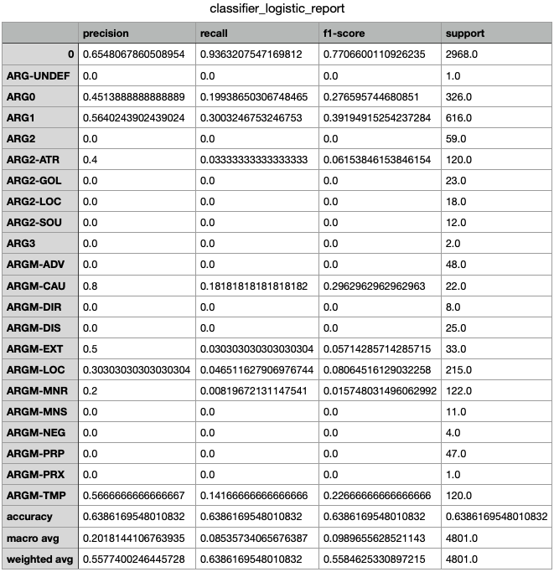
Logistic Regression Model Results
The model was able to achieve an accuracy of
63.8% on the test set

Slide 7
LSTM Model - Architecture
We train an LSTM model with the following hyperparameters and for 50 epochs
--EMBEDDING_DIM=300
--NUM_HIDDEN_NODES=100
--epochs=50
--batchsize=64
--learning_rate=0.001
Loss - Cross Entropy Loss
Optimizer - SGD with momentum=0.9
LSTM Neural Network Structure - SRL_LSTM(
(lstm): LSTM(300, 100, batch_first=True)
(fc): Linear(in_features=100, out_features=23, bias=True))

Slide 8
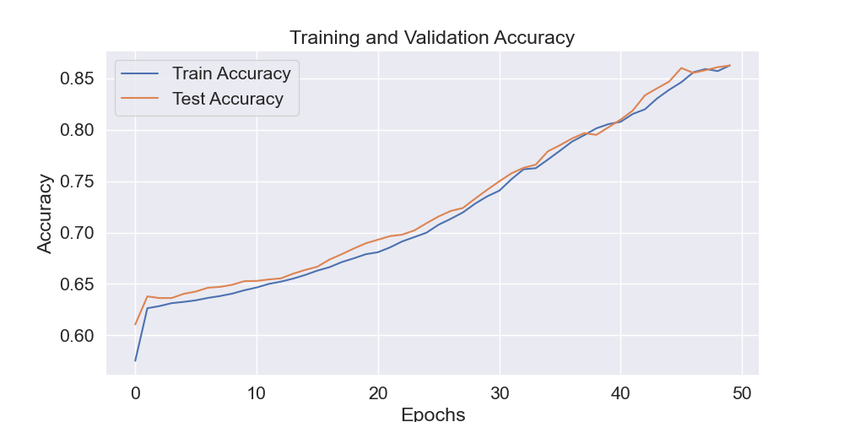
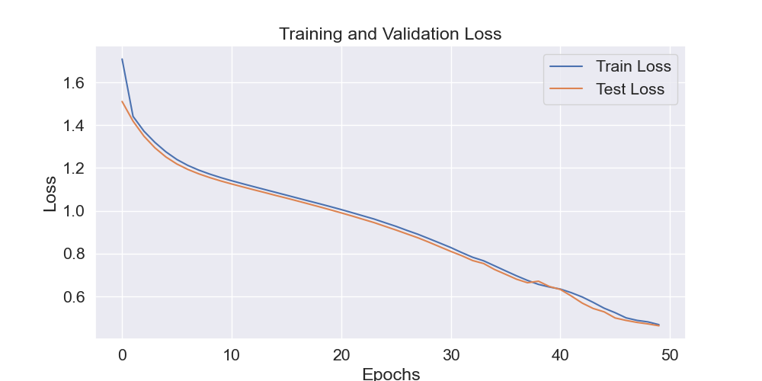
LSTM Model - Results
The model was able to achieve an accuracy of 86% on the test set after training for 50 epochs

Slide 9
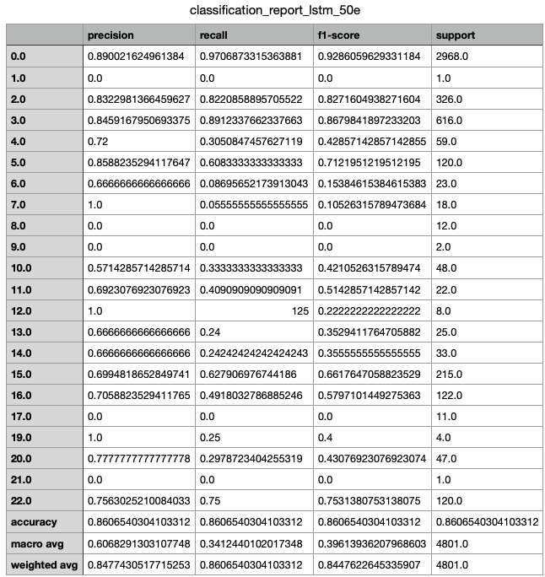
LSTM Model - Classification Report

Slide 10
Bidirectional LSTM - Architecture
We train an LSTM model with the following hyperparameters and for 50 epochs
--EMBEDDING_DIM=300
--NUM_HIDDEN_NODES=100
--epochs=50
--batchsize=64
--learning_rate=0.001
Loss - Cross Entropy Loss
Optimizer - SGD with momentum=0.9
Bidirectional layer -
self.lstm = nn.LSTM(embeddings_dim,hidden_dim,num_layers=1,bidirectional=True,batch_first=True)
Bidirectional LSTM Neural Network Structure - SRL_LSTM(
(lstm): LSTM(300, 100, batch_first=True)
(fc): Linear(in_features=100, out_features=23, bias=True))

Slide 11
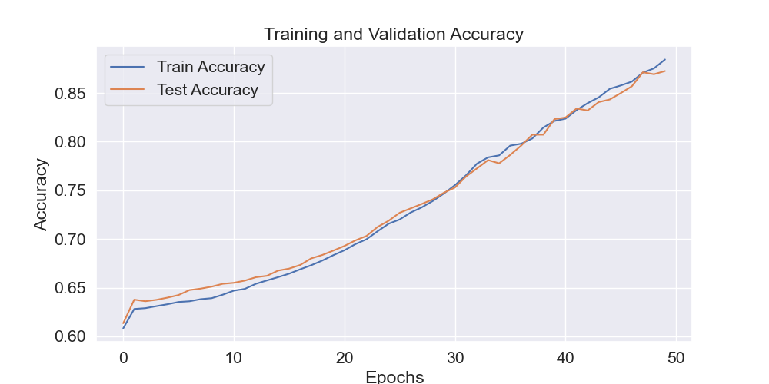
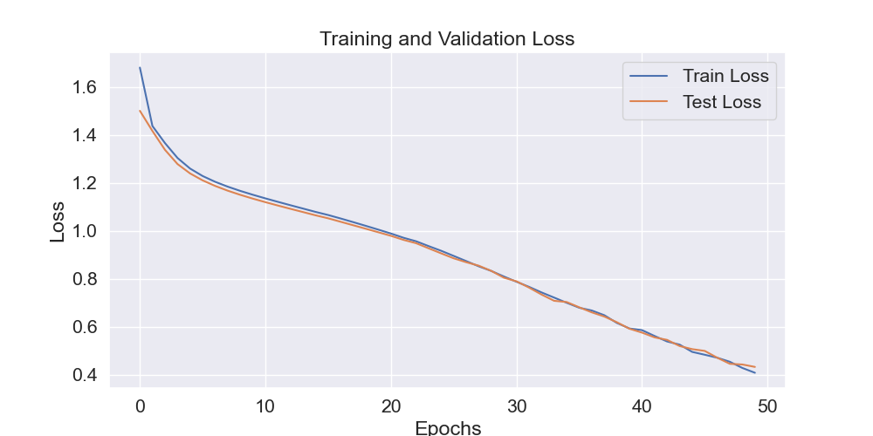
Bidirectional LSTM - Results
The model was able to achieve an accuracy of 87.1% on the test set after training for 50 epochs

Slide 12
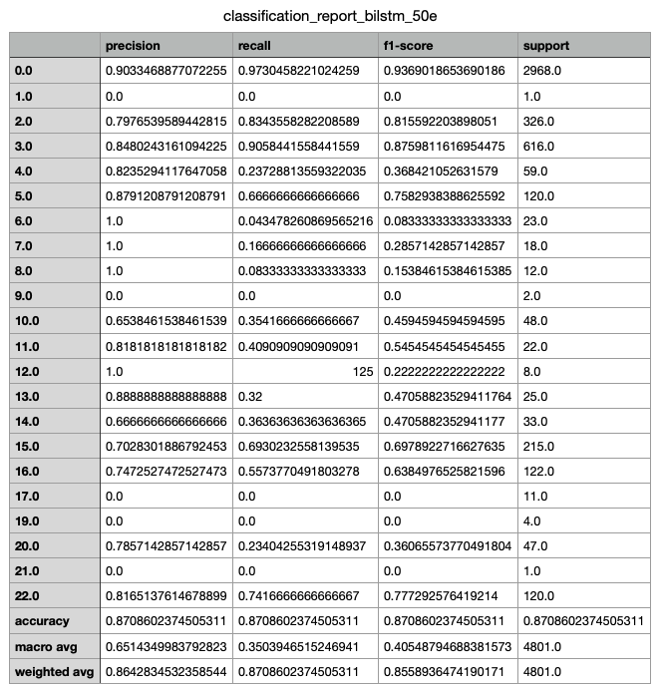
Bidirectional LSTM Model - Classification Report

Slide 13
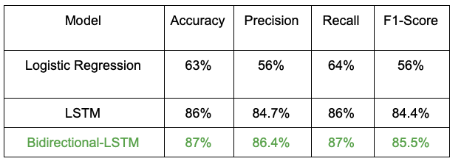
Summary
Conclusion - We conclude that the Bidirectional LSTM is the best model for the SRL Task on Hindi Propbank dataset.

Slide 14
References
Deep Semantic Role Labeling: What Works and What’s Next by Luheng He
https://www.aclweb.org/anthology/P17-1044.pdf
In their paper, they have also used bidirectional LSTM to solve the SRL problem

